Slide 1


Austing Dong
2023.10.22

Slide 2

Outline
Executive Summary
Introduction
Methodology
Results
Conclusion
Appendix

Slide 3
Executive Summary
Summary of methodologies
Data Collection via API
Data Collection via Web Scraping
Data Wrangling
Exploratory Data Analysis (EDA) with Data Visualization
Exploratory Data Analysis (EDA) with SQL
Building interactive map with Folium & Dash
Prediction
Summary of all results
EDA result
Machine Learning result

Slide 4
Introduction
Project background and context
Target: improve SpaceX Falcon 9 rockets’ successful rate
Problems
Find factors influence landing process
Find relations between variables and their contribution to the influence
Find the best conditions that will cause a successful landing

Slide 5

Section 1

Slide 6
Methodology
Executive Summary
Data collection methodology:
Make get request from SpaceX API
Perform Web Scraping from Wikipedia
Data Wrangling
Perform exploratory data analysis (EDA) using visualization and SQL
Perform interactive visual analytics using Folium and Plotly Dash
Perform predictive analysis using classification models
How to build, tune, evaluate classification models

Slide 7
Data Collection
API
Web Scraping
Transform to JSON
Convert to Pandas Data frame
Use get request
Send request
Use Beautiful Soup to decode
Convert to Pandas Data frame

Slide 8
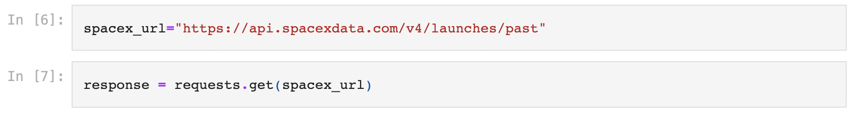
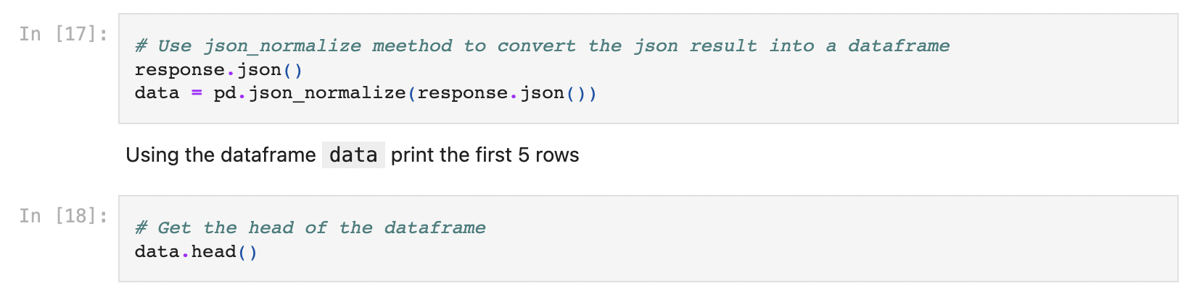
Data Collection – SpaceX API
Transform to JSON
Convert to Pandas Data frame
Use get request
Link

Slide 9
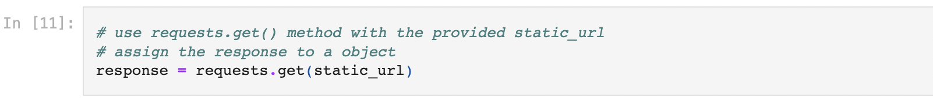
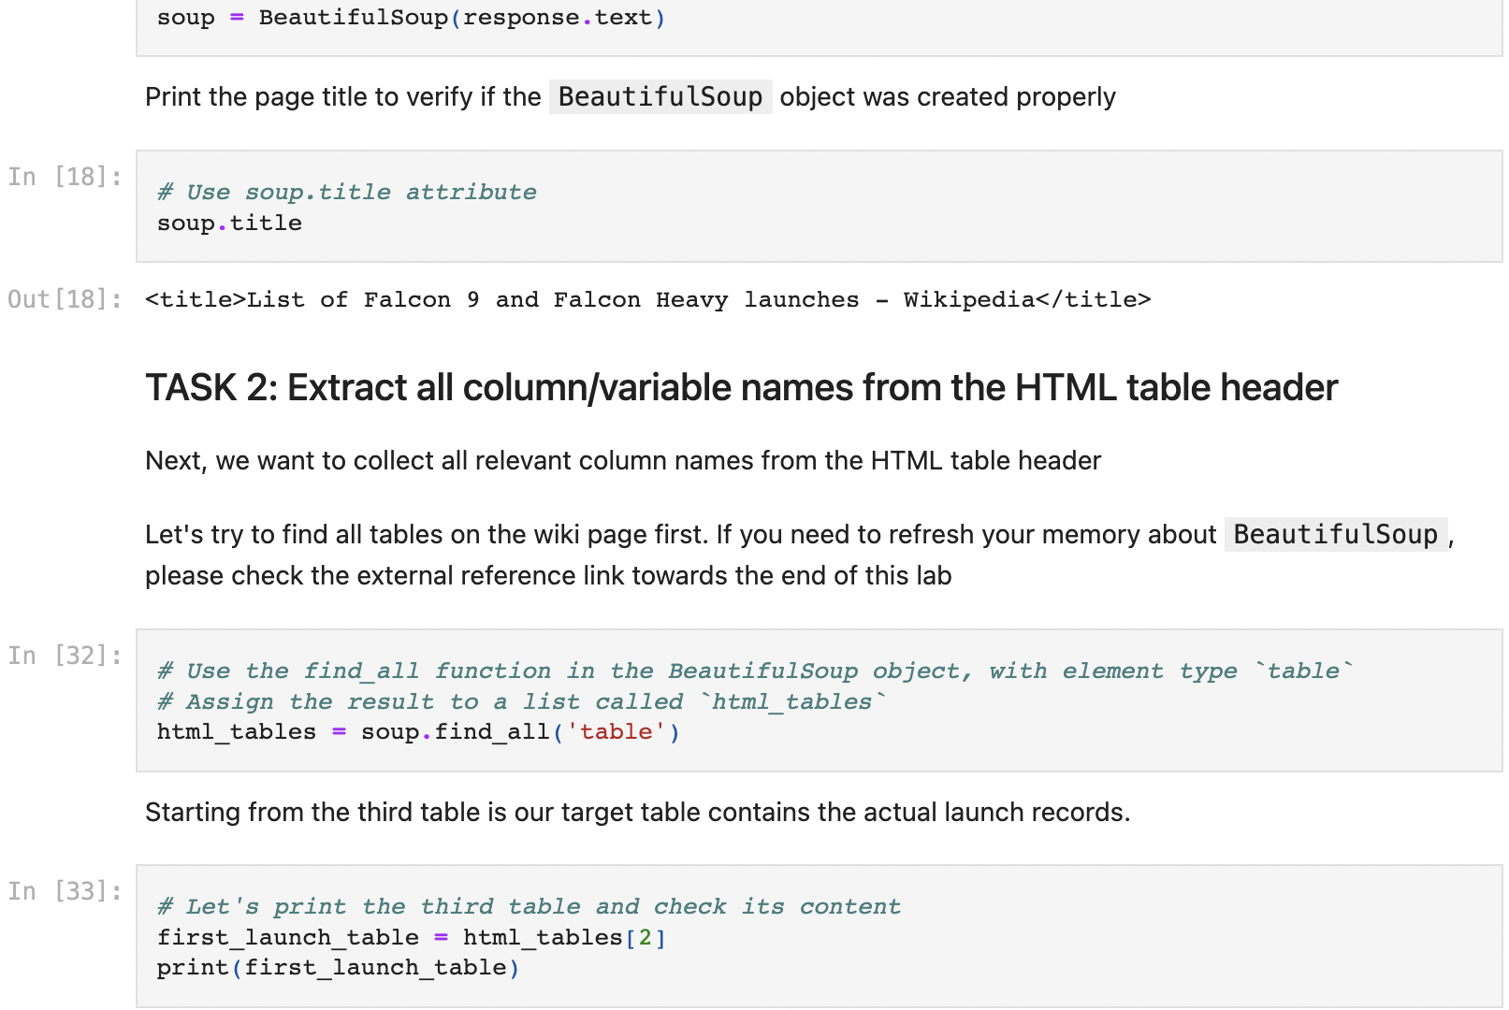
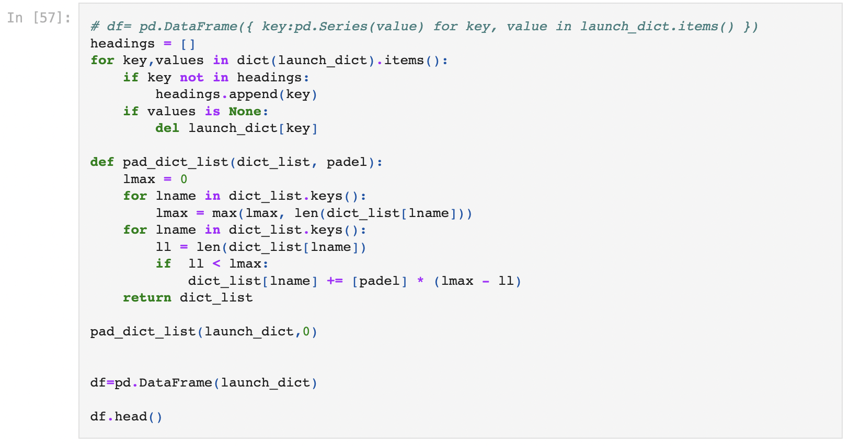
Data Collection - Scraping
Send request
Use Beautiful Soup to decode
Convert to Pandas Data frame
Link

Slide 10
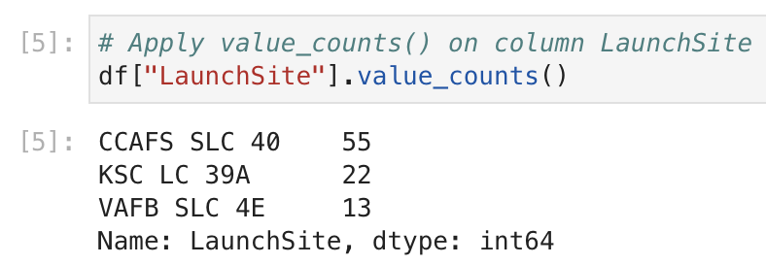
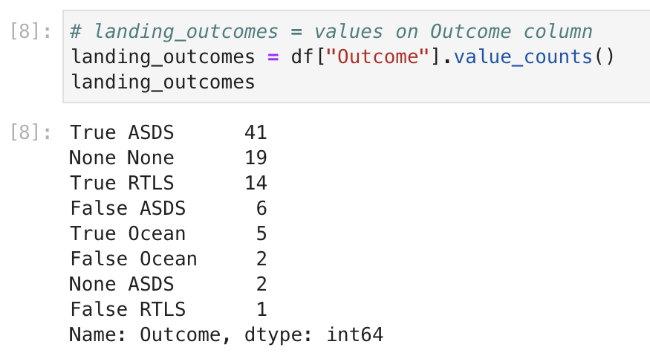
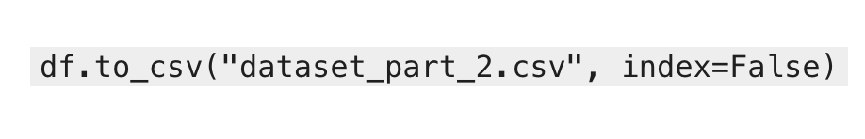
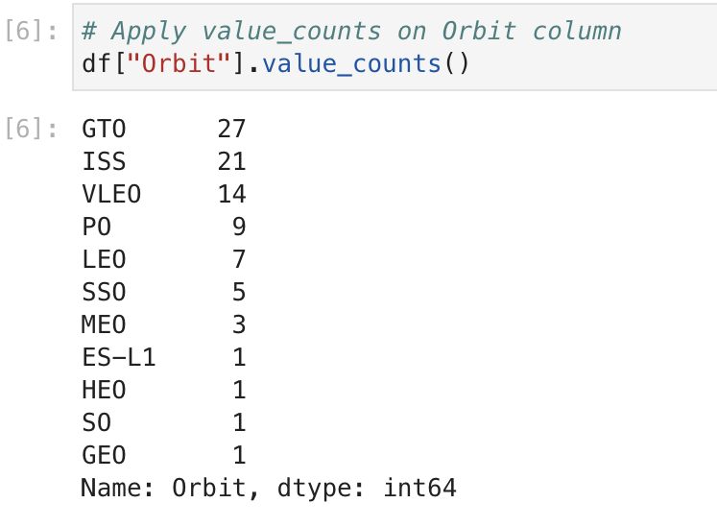
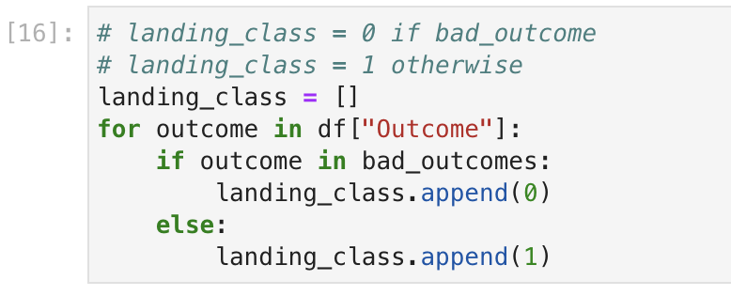
Data Wrangling
Launch number for each site
Number and occurrence each orbit
Mission outcome each orbit
Labeling landing outcome
Export

Slide 11
EDA with Data Visualization
Scatter Graph – visualize correlations between variables
Flight Number vs. Launch Site
Payload Mass vs. Launch Site
Success Rate vs. Orbit Type
Flight Number vs. Orbit Type
Payload Mass vs. Orbit Type
Line Graph – visualize trends
Launch Success Yearly Trend
Bar Graph – relationship between numerical and categorical variables
Orbit Type vs. Success Rate
Link

Slide 12
EDA with SQL
SQL queries:
Display the names of the unique launch sites in the space mission
Display 5 records where launch sites begin with the string 'CCA’
Display the total payload mass carried by boosters launched by NASA (CRS)
Display average payload mass carried by booster version F9 v1.1
List the date when the first successful landing outcome in ground pad was achieved.
List the names of the boosters which have success in drone ship and have payload mass greater than 4000 but less than 6000
List the total number of successful and failure mission outcomes
List the names of the booster_versions which have carried the maximum payload mass. Use a subquery
List the records which will display the month names, failure landing_outcomes in drone ship ,booster versions, launch_site for the months in year 2015.
Rank the count of landing outcomes (such as Failure (drone ship) or Success (ground pad)) between the date 2010-06-04 and 2017-03-20, in descending order.
Link

Slide 13
Build an Interactive Map with Folium
Using red circle to locate launch sites’ area, containing
Marker clusters: indicating multiple launches in the same place
Red Icon: indicating a failed launch
Green Icon: indicating a successful launch
Markers showing distance between key locations
It shows more details on the location, number, distances.
Link

Slide 14
Build a Dashboard with Plotly Dash
Summarize what plots/graphs and interactions you have added to a dashboard
Explain why you added those plots and interactions
Add the GitHub URL of your completed Plotly Dash lab, as an external reference and peer-review purpose

Slide 15
Predictive Analysis (Classification)
Summarize how you built, evaluated, improved, and found the best performing classification model
You need present your model development process using key phrases and flowchart
Add the GitHub URL of your completed predictive analysis lab, as an external reference and peer-review purpose

Slide 16
Results
Exploratory data analysis results
Interactive analytics demo in screenshots
Predictive analysis results

Slide 17

Section 2

Slide 18
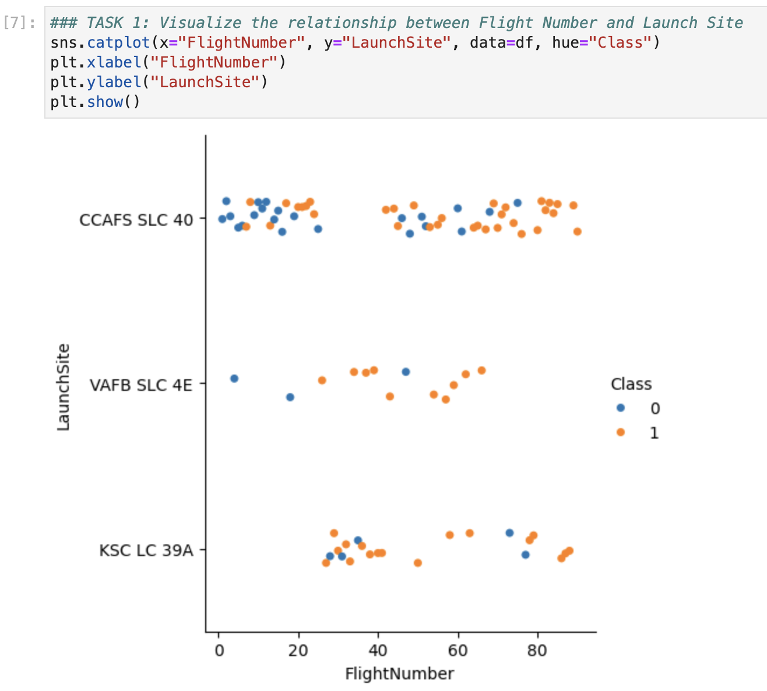
Flight Number vs. Launch Site
We find that:
As flight number increase, each launch site tend to success
CCAFS SLC 40 has the most frequent launch samples
VAFB SLC 4E tend to have a higher successful rate

Slide 19
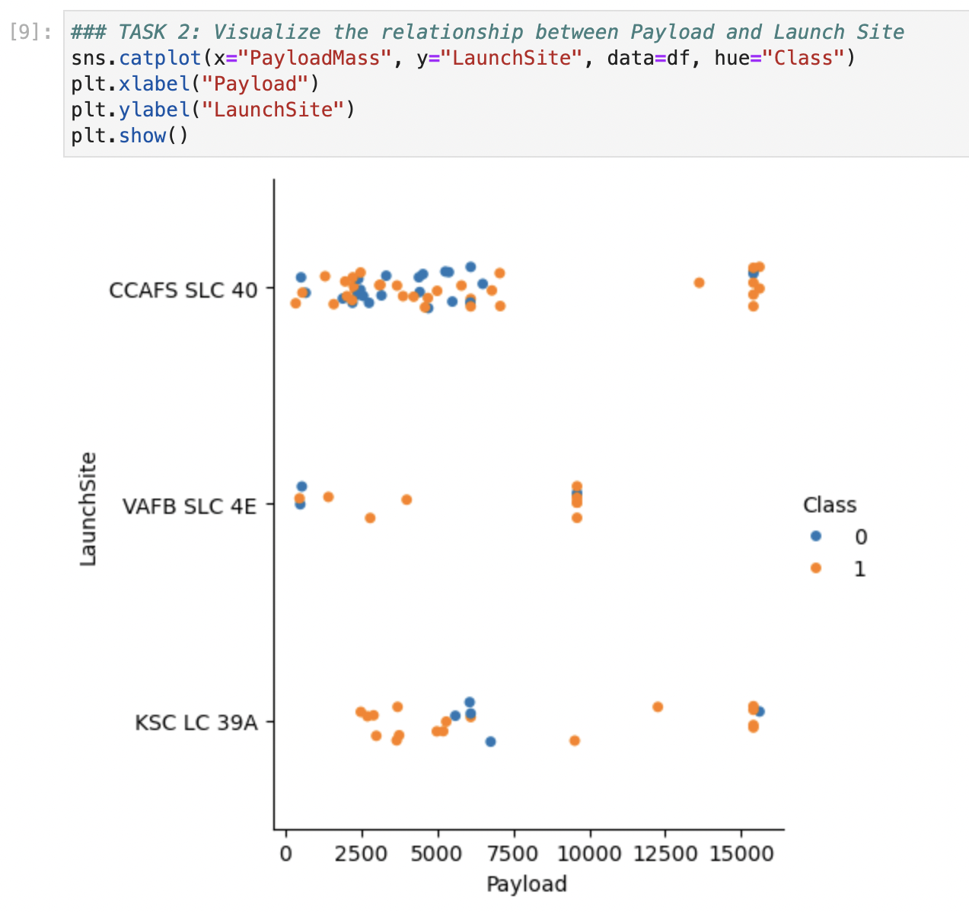
Payload vs. Launch Site
We find that:
Higher Payload (>7500) may lead to a better successful rate for these Launch Sites
However, too much Payload like 15000 may lead to some failures

Slide 20
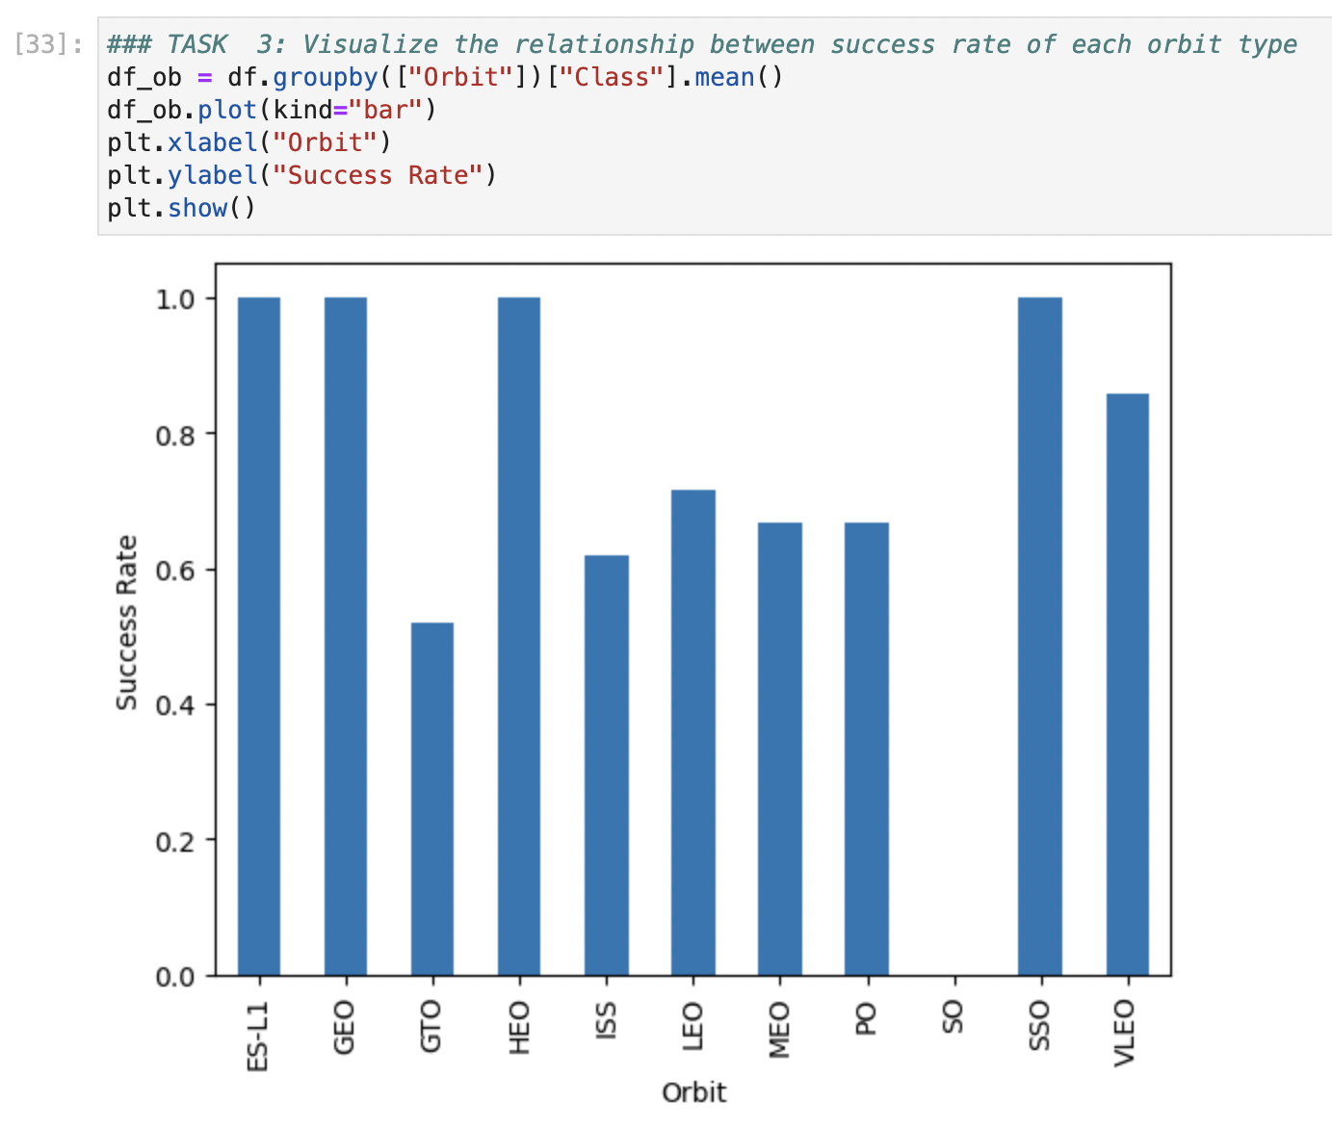
Success Rate vs. Orbit Type
We find that:
ES-L1, GEO, HEO, and SSO have the best Successful Rate

Slide 21
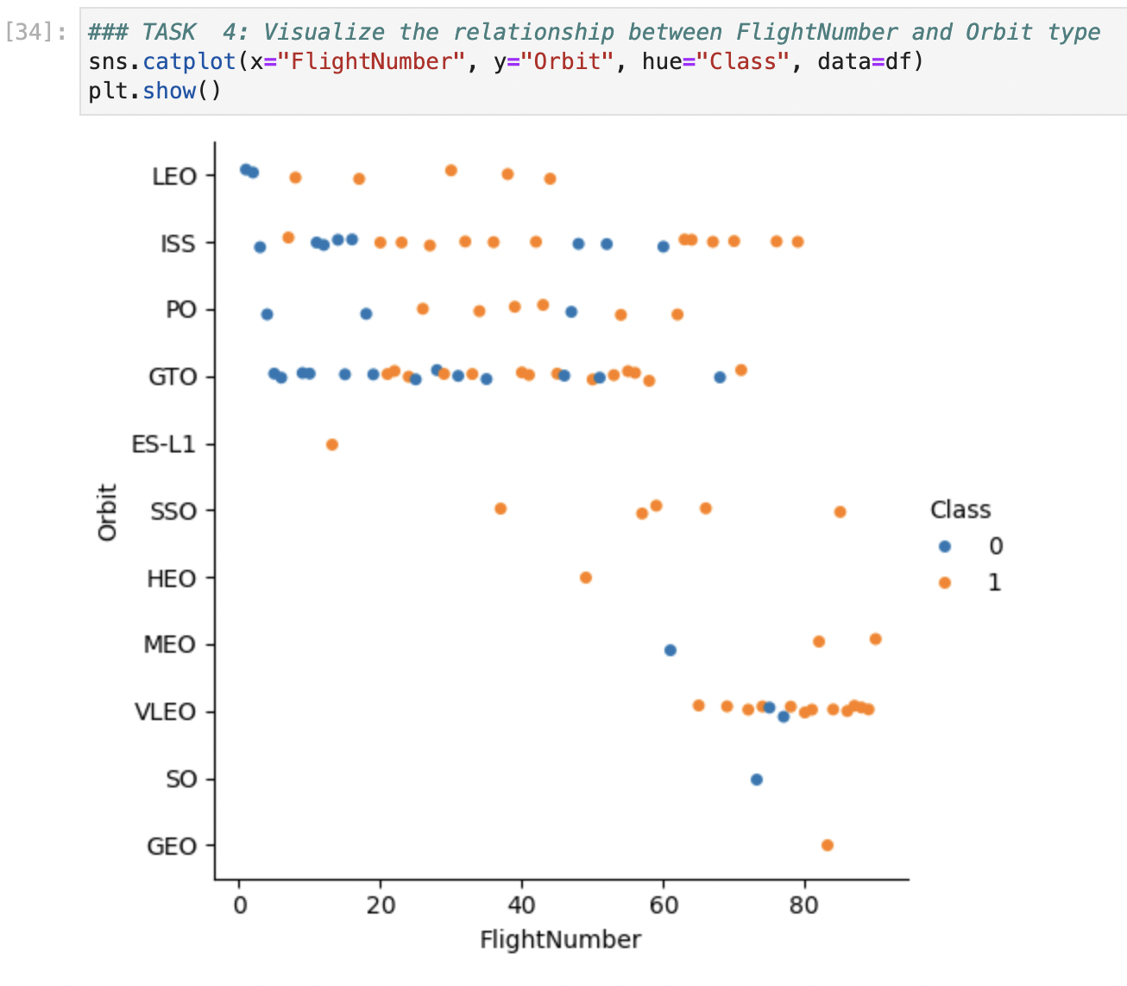
Flight Number vs. Orbit Type
We find that:
As Flight Number increases, LEO, PO, VLEO are more likely to success
GTO tends to have no relationships between Flight Number and Success

Slide 22
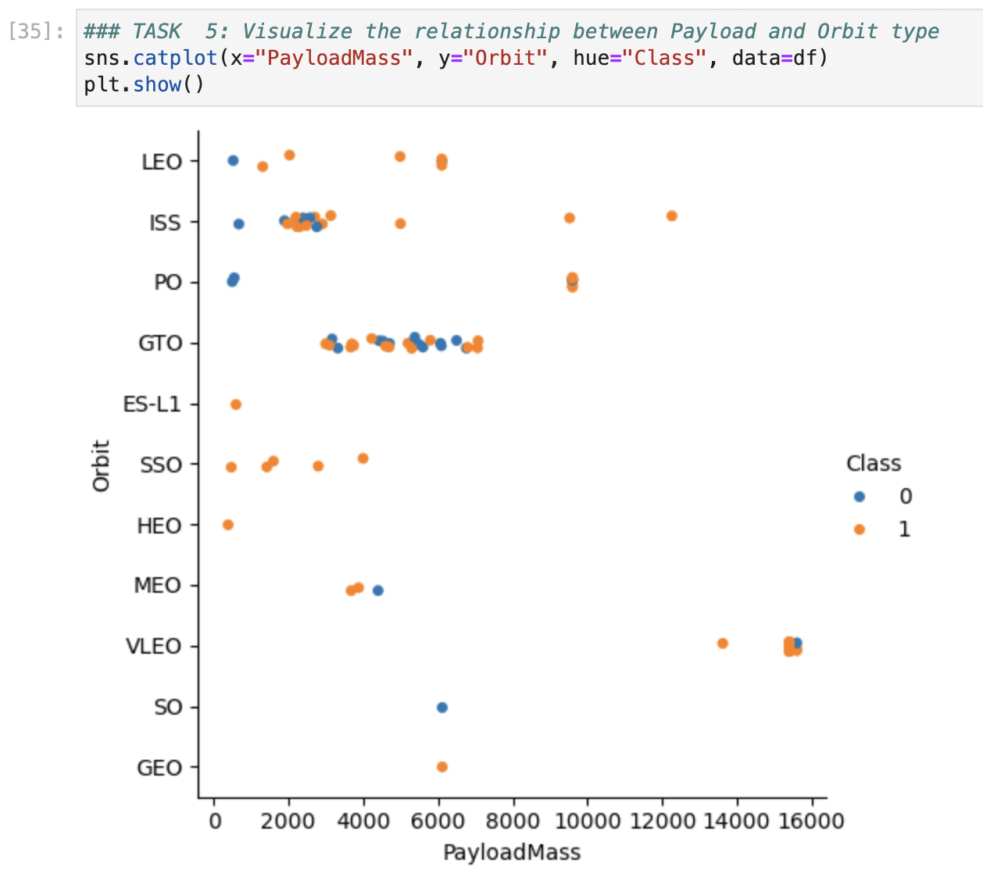
Payload vs. Orbit Type
We find that:
For most Orbits, a higher Payload Mass are more possible to success
However, for GTO, we cannot find a significant relationship between Payload Mass and success

Slide 23
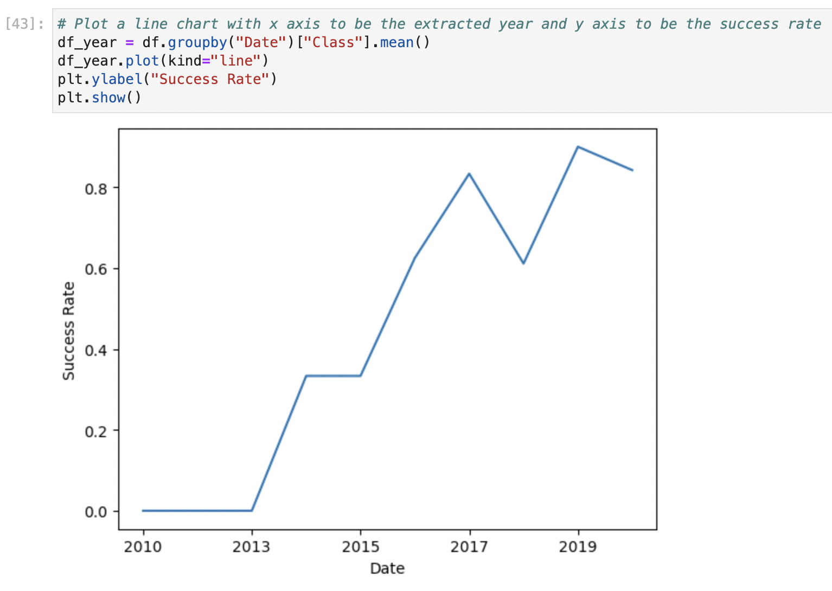
Launch Success Yearly Trend
We find that:
From 2010-2020, the Success Rate tend to increase over years.
There is a small decrease of Success Rate in 2018

Slide 24
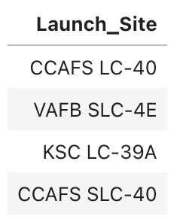
All Launch Site Names
SQL query:
SELECT DISTINCT launch_site FROM SPACEXTBL
Explanation:
DISTINCT: make launch_site unique

Slide 25
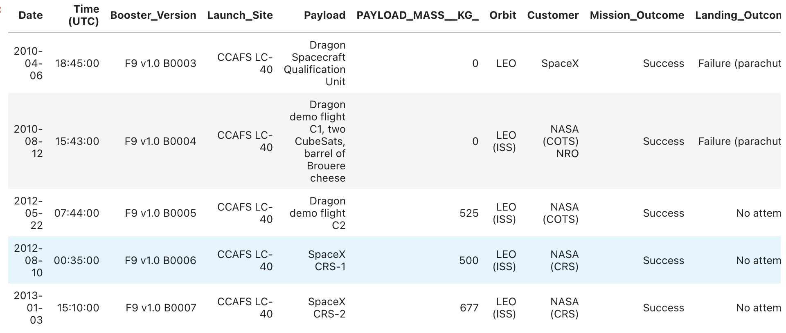
Launch Site Names Begin with 'CCA'
SQL query:
SELECT * FROM SPACEXTBL WHERE launch_site LIKE "CCA%" LIMIT 5
Explanation:
WHERE launch_site LIKE “CCA%” implies the launch_site need to start with “CCA”
LIMIT 5 indicates that the result contains not more than 5 elements

Slide 26
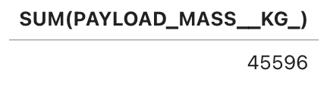
Total Payload Mass
SQL query
SELECT SUM(PAYLOAD_MASS__KG_) FROM SPACEXTBL WHERE customer="NASA (CRS)"
Explanation:
SUM(PAYLOAD_MASS__KG_) calculates the total sum of PAYLOAD_MASS__KG_
WHERE customer="NASA (CRS)” implies that we only select “NASA (CRS)” customers

Slide 27
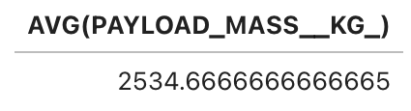
Average Payload Mass by F9 v1.1
SQL query
SELECT AVG(PAYLOAD_MASS__KG_) FROM SPACEXTBL WHERE Booster_Version LIKE "F9 v1.1%”
Explanation:
AVG(PAYLOAD_MASS__KG_) calculates the average of PAYLOAD_MASS__KG_
WHERE Booster_Version LIKE "F9 v1.1%” selects the Booster_Version start with "F9 v1.1%”

Slide 28
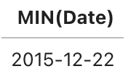
First Successful Ground Landing Date
SQL query:
SELECT MIN(Date) FROM SPACEXTBL WHERE Landing_Outcome LIKE "%Success%ground%pad%"
Explanation:
LIKE "%Success%ground%pad%” selects the Landing outcome containing ”Success”, “ground” “pad”

Slide 29
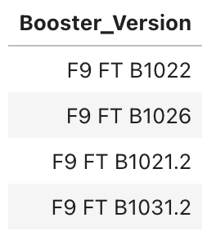
Successful Drone Ship Landing with Payload between 4000 and 6000
SQL query:
SELECT DISTINCT Booster_Version FROM SPACEXTBL WHERE Landing_Outcome LIKE "%Success%drone%ship%" AND PAYLOAD_MASS__KG_ > 4000 AND PAYLOAD_MASS__KG_ < 6000
Explanation:
LIKE “%Success%drone%ship%” filters the successful landing outcome on drone ship
Use AND to connect the conditions “>4000”, “<6000” to show that payload mass is in range (4000, 6000)

Slide 30
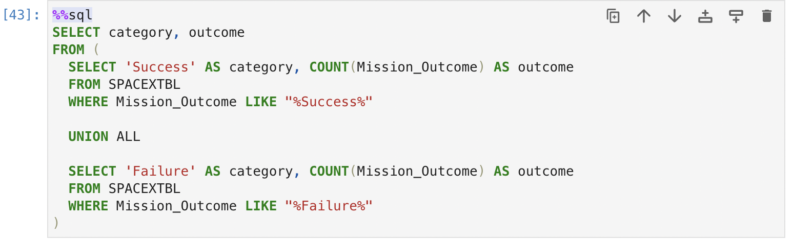
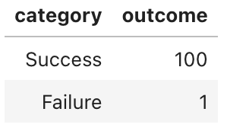
Total Number of Successful and Failure Mission Outcomes
SQL query:
Explanation:
Select Success and Failure samples separately
Use UNION to connect them

Slide 31

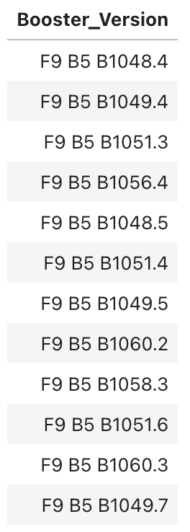
Boosters Carried Maximum Payload
SQL query:
Explanation:
Use another SELECT query to get max payload mass

Slide 32
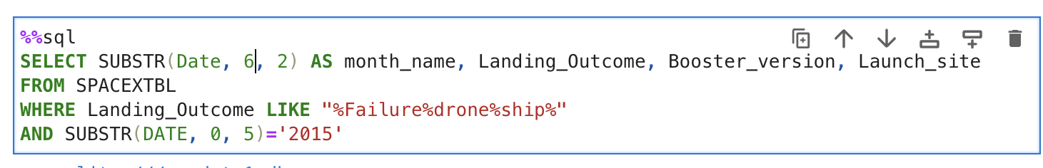
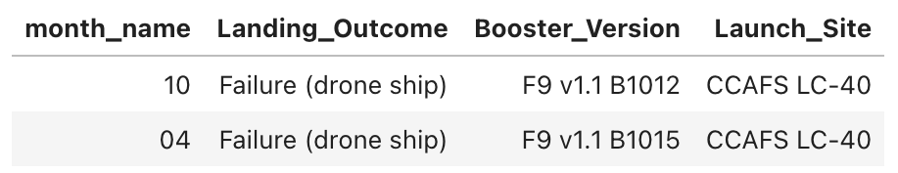
2015 Launch Records
SQL query:
Explanation:
Use SUBSTR to get month and year

Slide 33
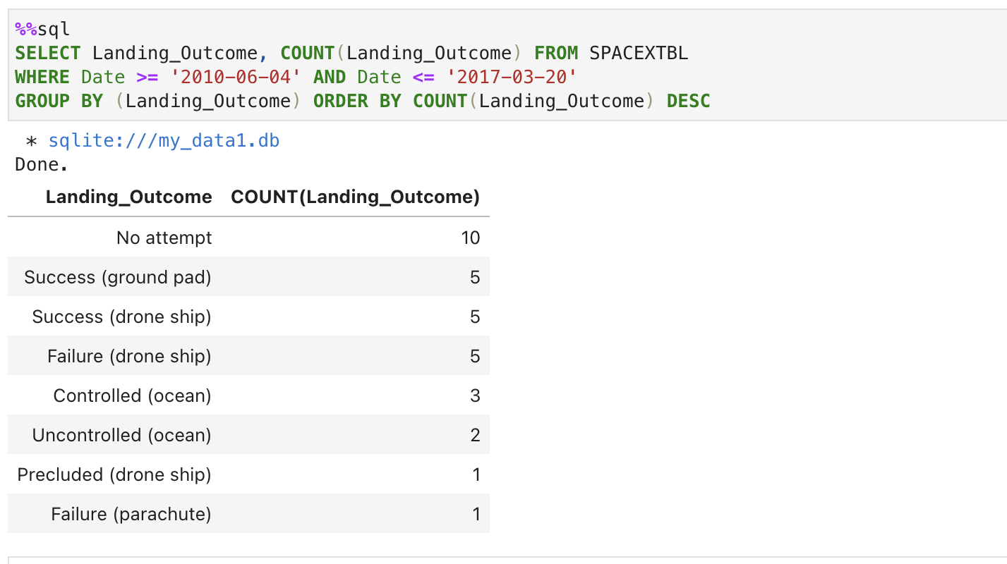
Rank Landing Outcomes Between 2010-06-04 and 2017-03-20
SQL query:
Explanation:
Use ORDER BY to rank by count of landing outcome
Use DESC to rank in descending order

Slide 34

Section 3

Slide 35
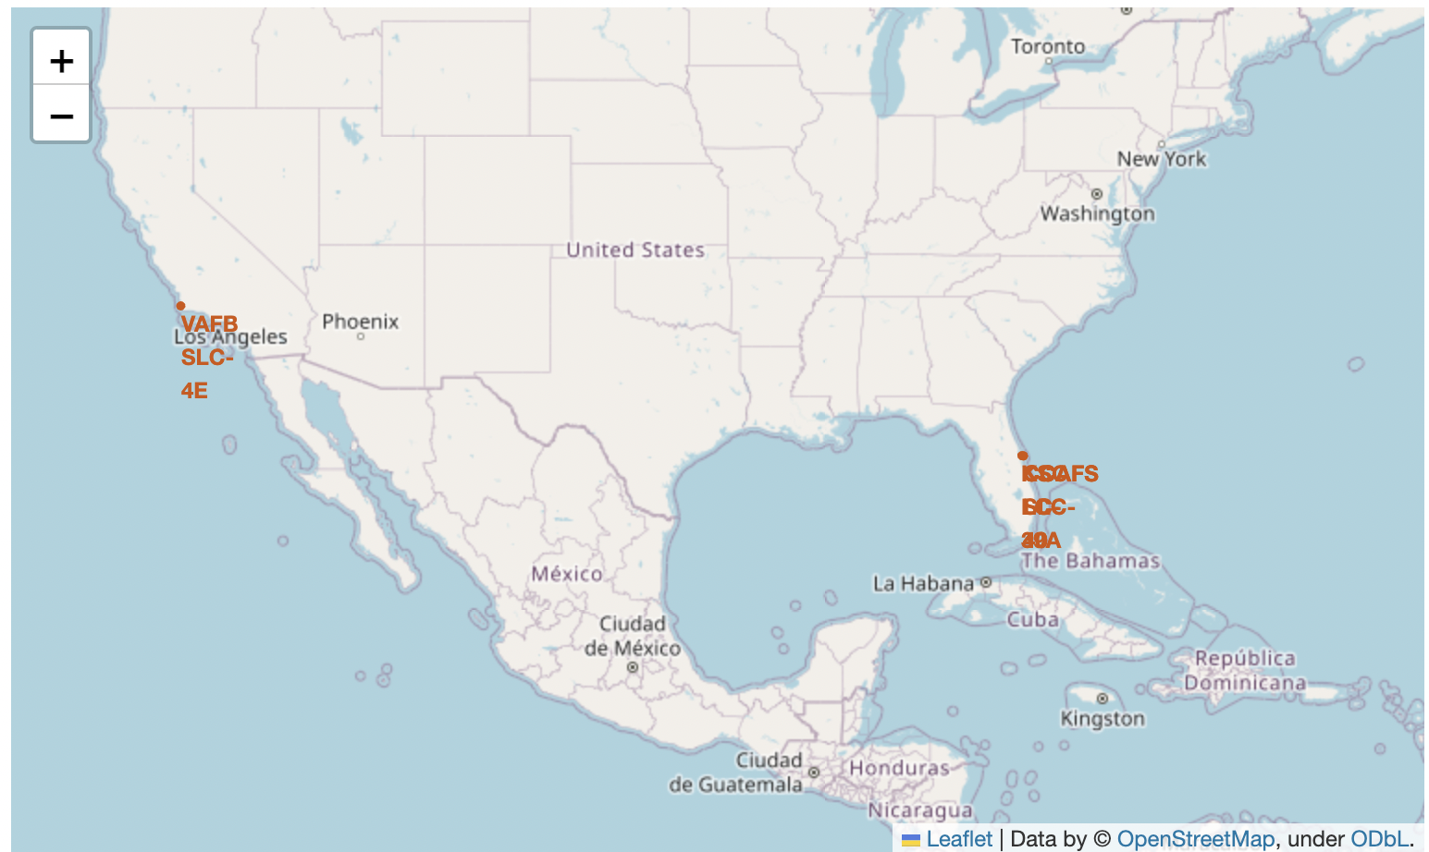
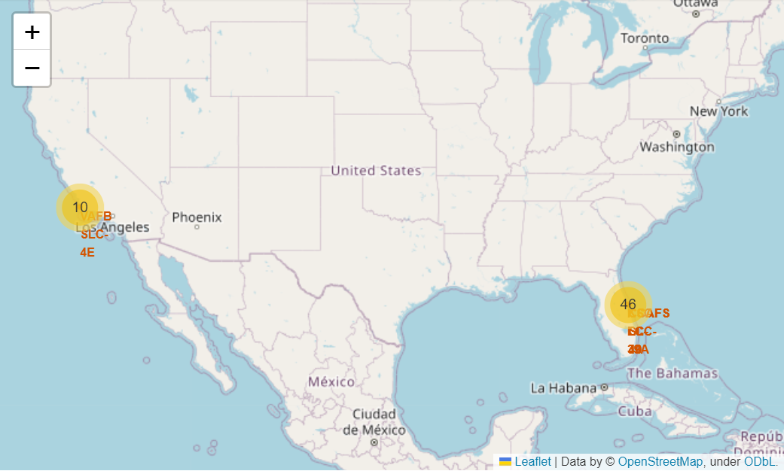
Folium Map – All launch sites
All launch sites’ location markers on a global map
It shows that all launch sites are near the coast, most are in east coasts

Slide 36
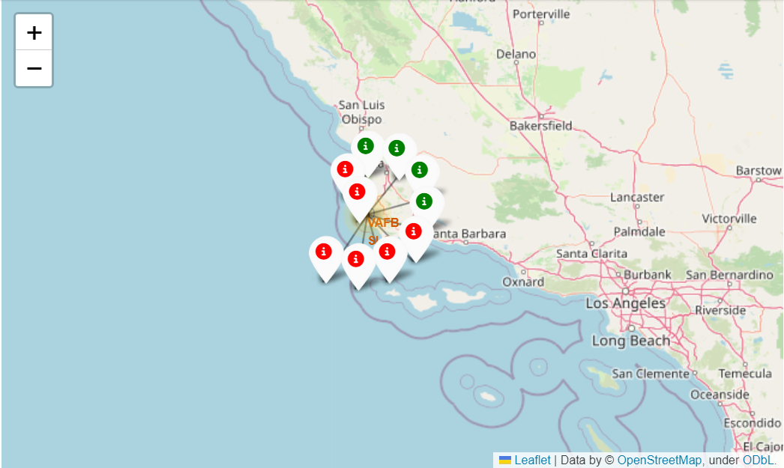
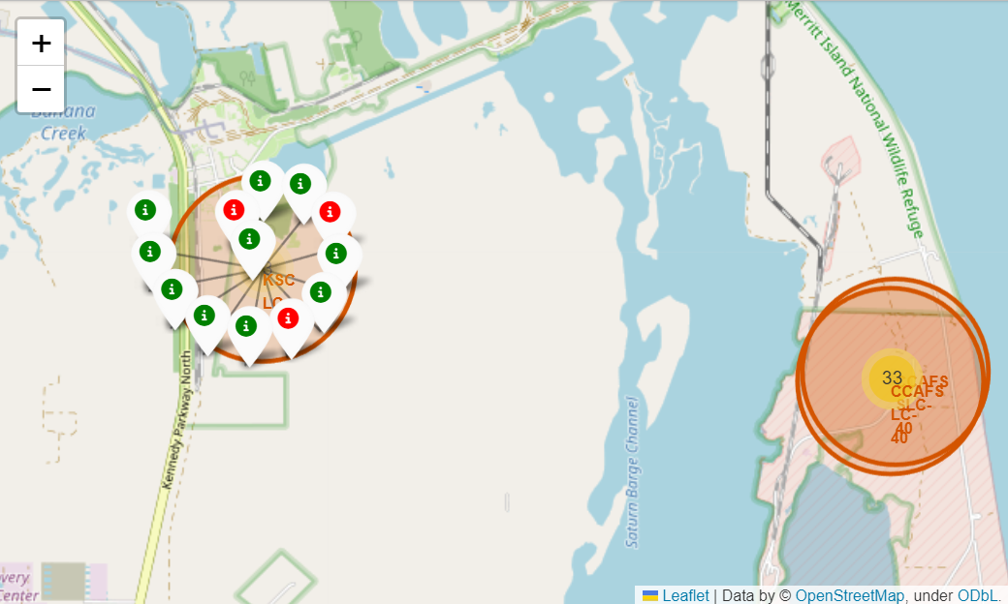
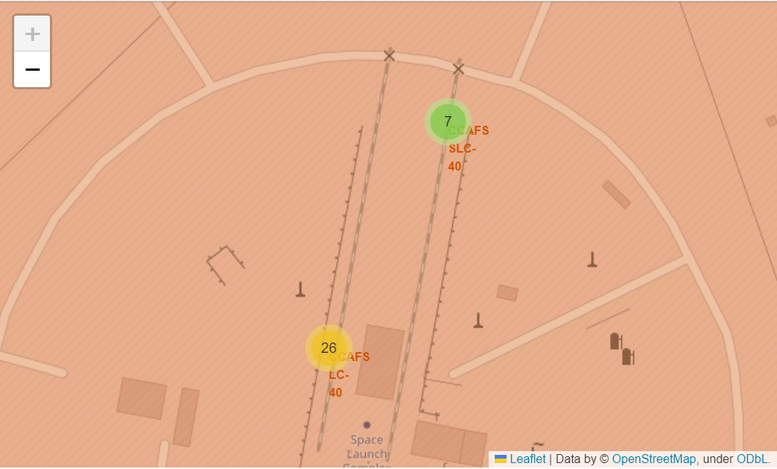
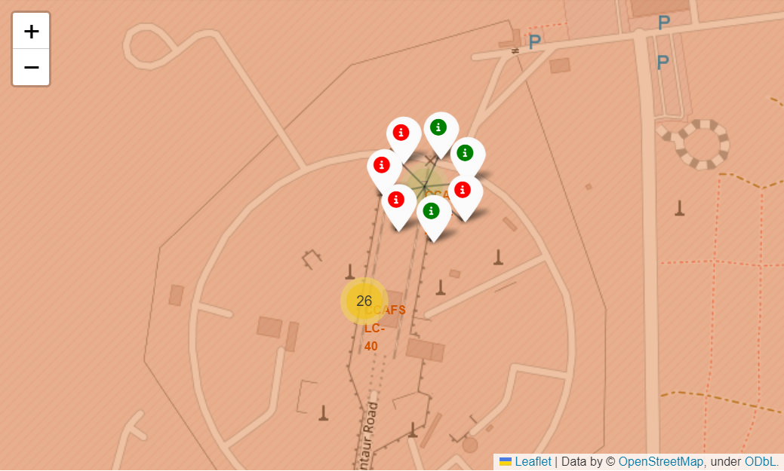
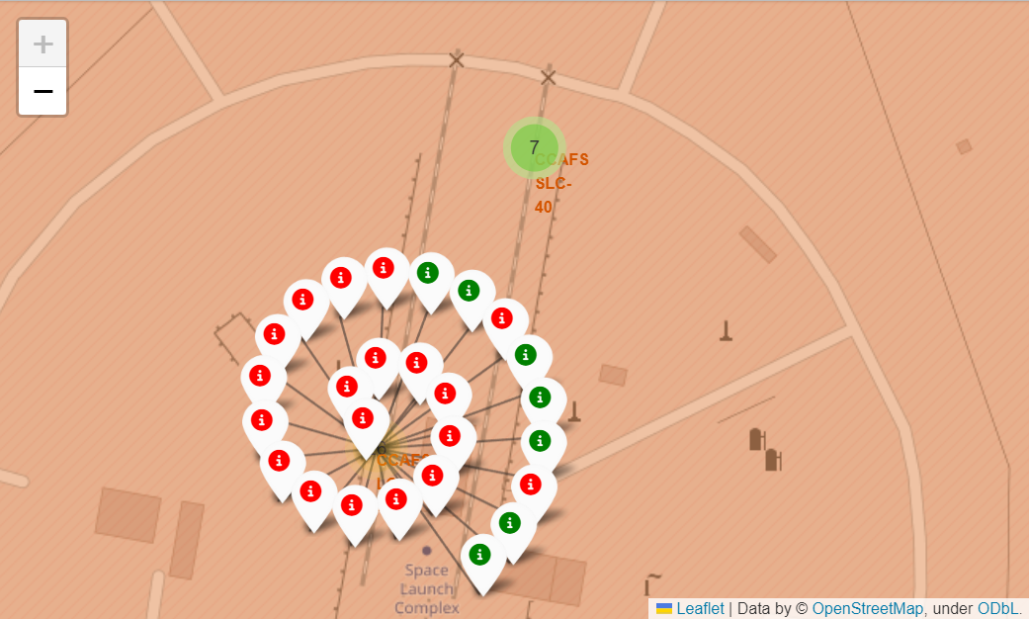
Folium Map – Labeled launch outcomes
color-labeled launch outcomes (Green icon: successful, Red icon: fail)
West Coast: (VAFBSLC-4E)
East Coast: (KSCLC-39A, CCAFS-SLC-40)
East coast launches more successful than west coast. In east coast, KSCLC-39A is likely to be more successful than CCAFS-SLC-40

Slide 37
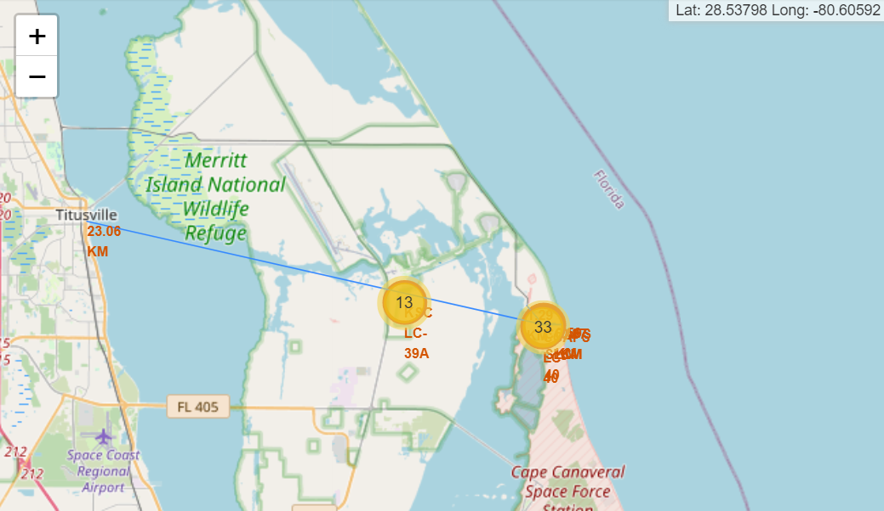
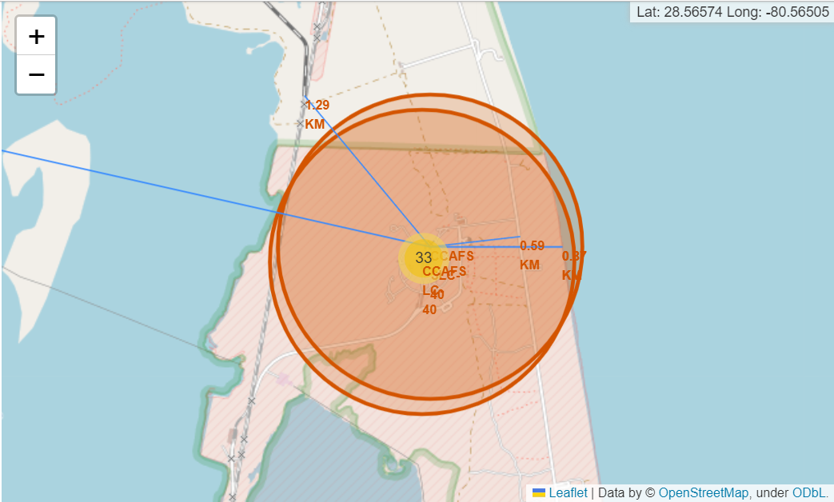
Folium Map – Distances
Are launch sites in close proximity to railways? Yes
Are launch sites in close proximity to highways? Yes
Are launch sites in close proximity to coastline? Yes
Do launch sites keep certain distance away from cities? No

Slide 38

Section 4

Slide 39
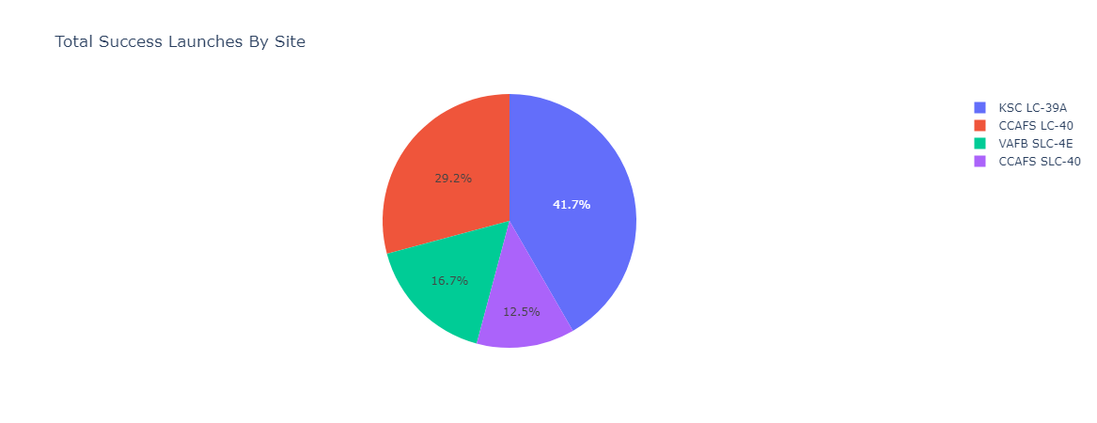
Dashboard – Pie chart of launch success count for all sites

Slide 40
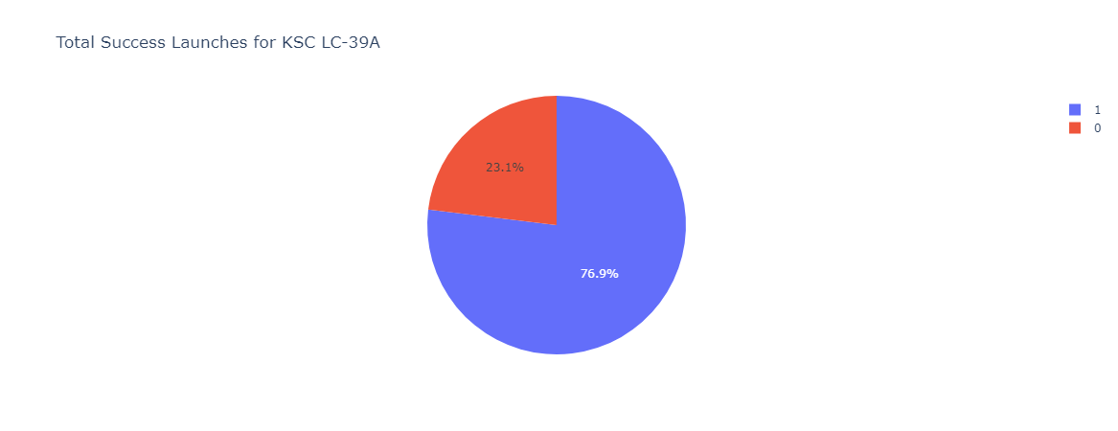
Dashboard – Pie chart for the launch site with highest launch success ratio

Slide 41
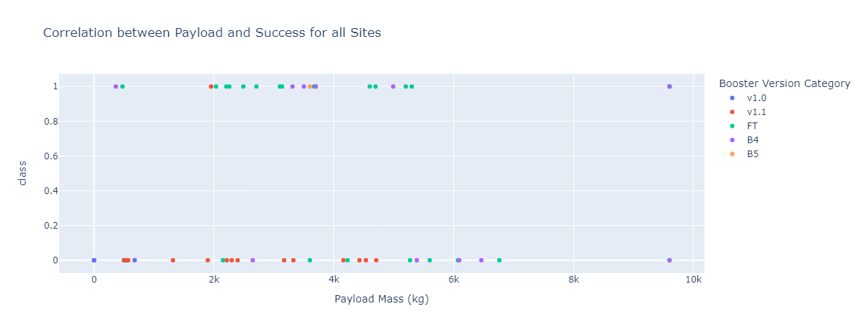
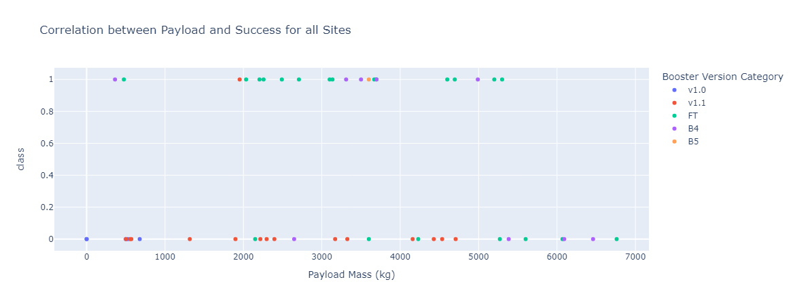
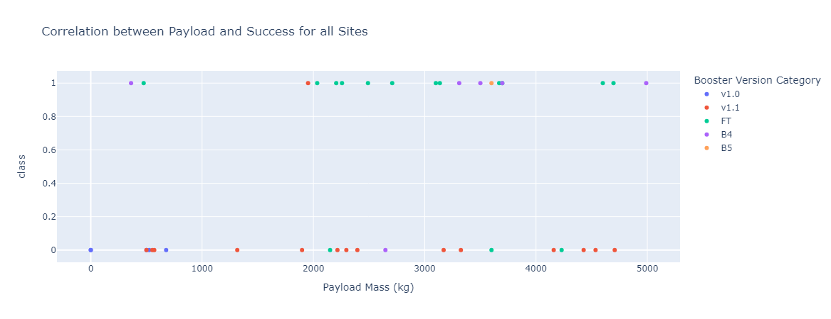
Dashboard – Payload vs. Launch Outcome scatter plot for all sites

Slide 42

Section 5

Slide 43
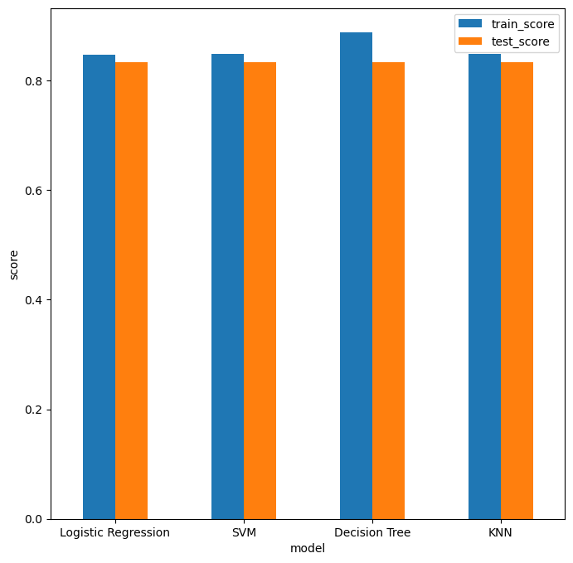
Classification Accuracy
From the bar chart, Decision Tree has the highest classification accuracy

Slide 44

Confusion Matrix

Slide 45
Conclusions
• There are several factors influences the result, such as the launch site, the orbit and especially the number of previous launches.
• Orbits with the best success rates: GEO, HEO, SSO, ES-L1.
• Generally heavy weighted payloads perform better than low weighted payloads.
• We choose the Decision Tree Algorithm as the best model for its better training accuracy. However, the test accuracy between all the models used is identical.

Slide 46


